Slide 1
NH3 over USA, India and China
Zhenqi Luo 2021.5
Notes:
https://doi.org/10.5194/acp-20-2277-2020

Slide 2
Progress & Plan
1. Compare with other studies
US
2. Compare with independent dataset
FAOSTAT

Slide 3
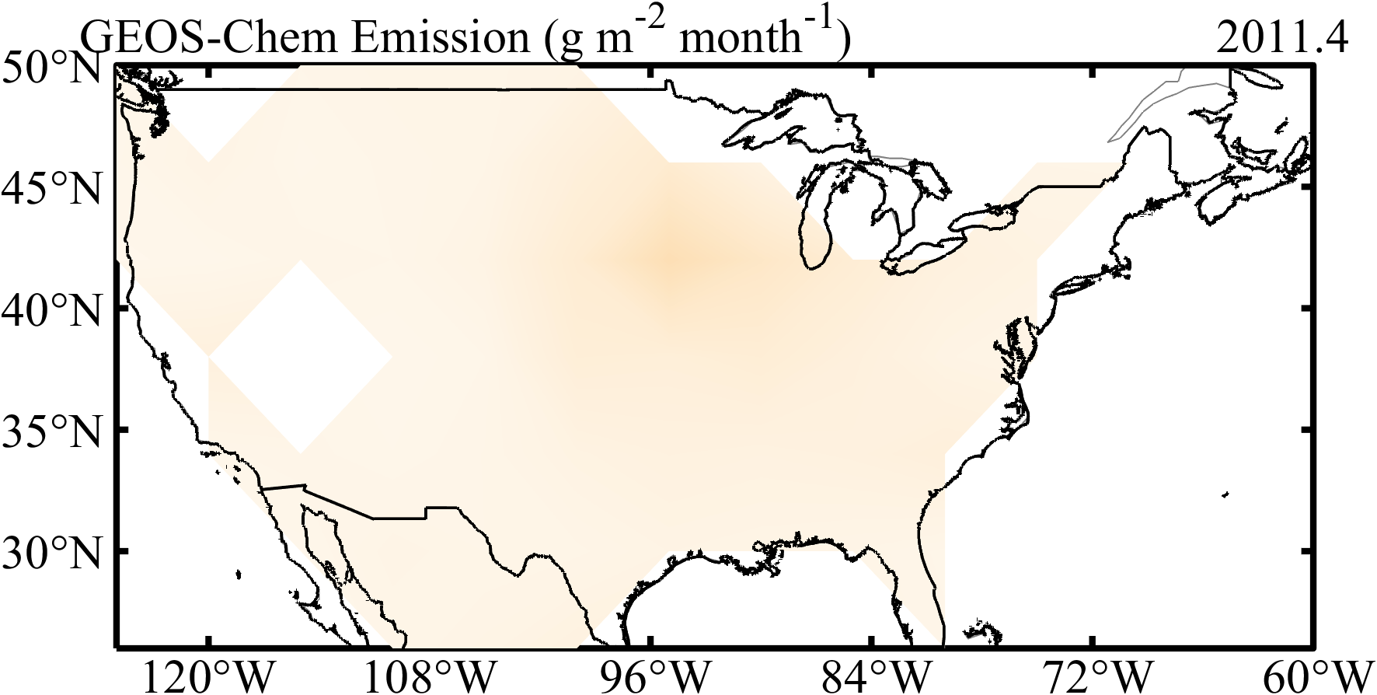
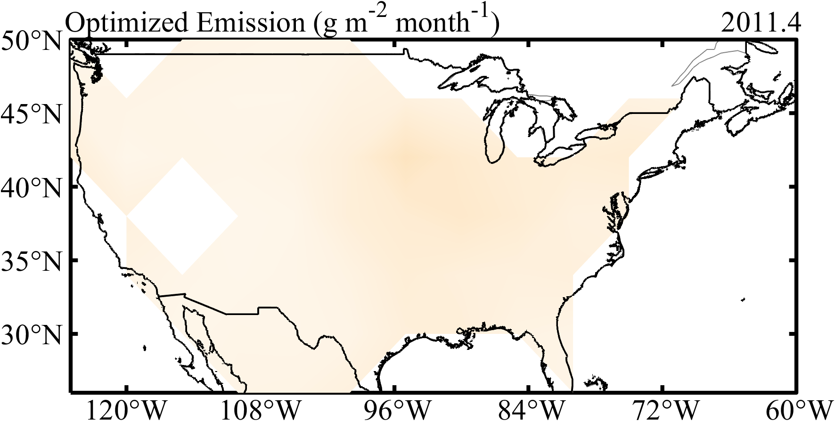
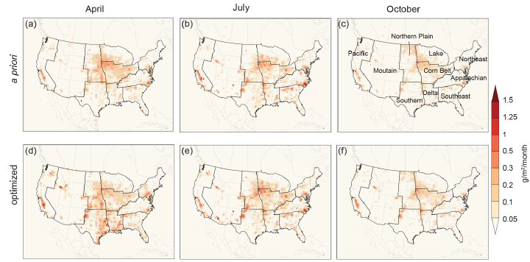
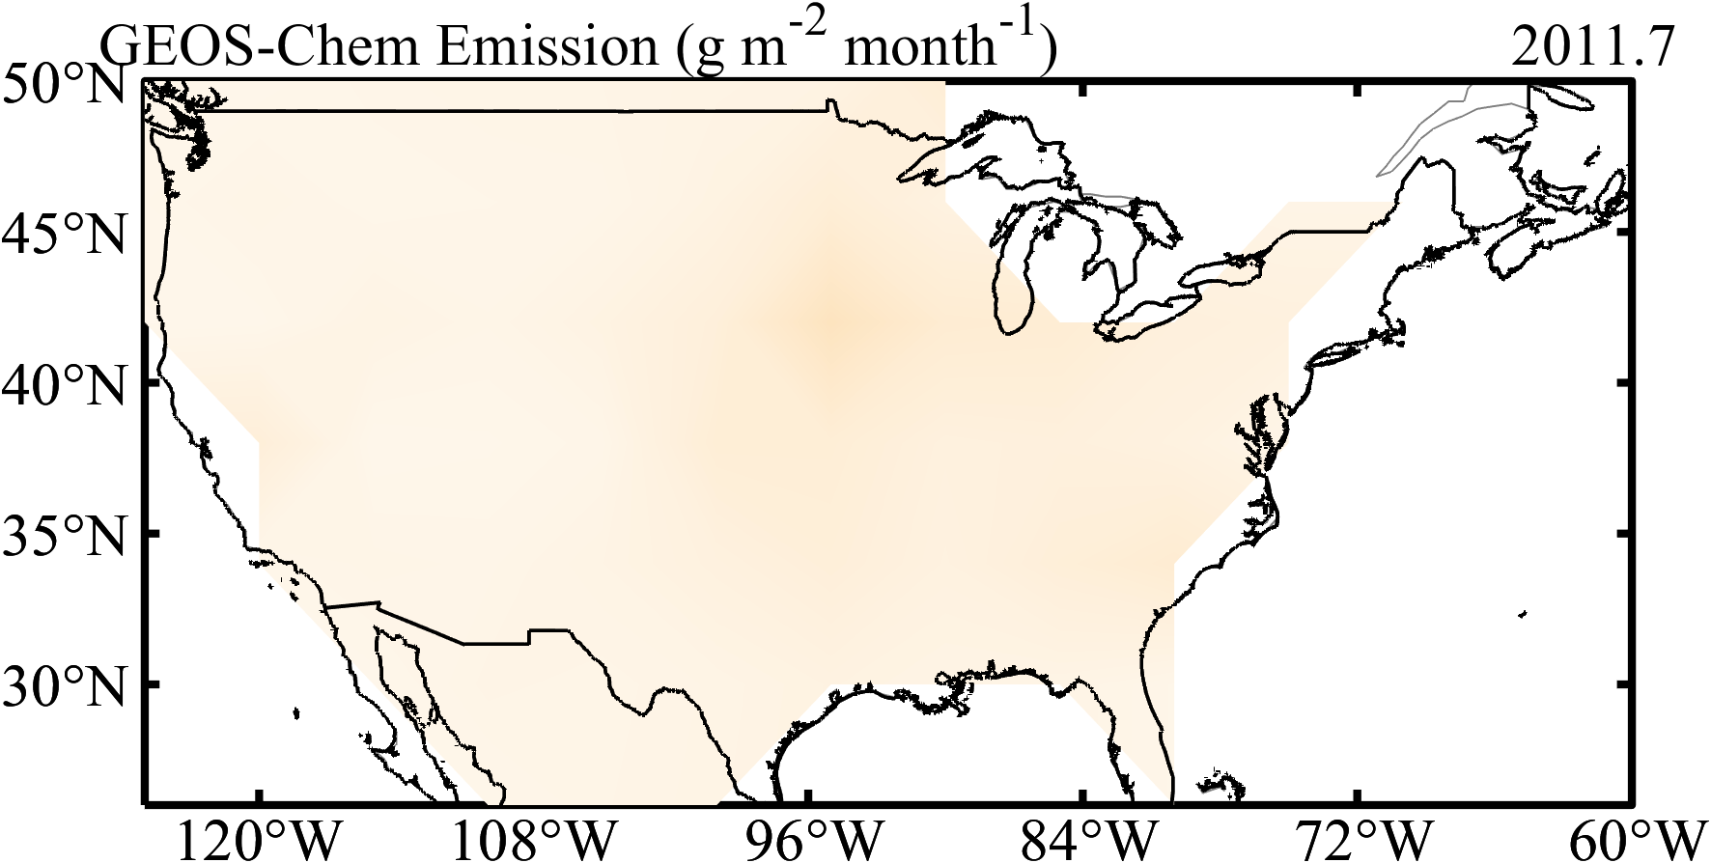
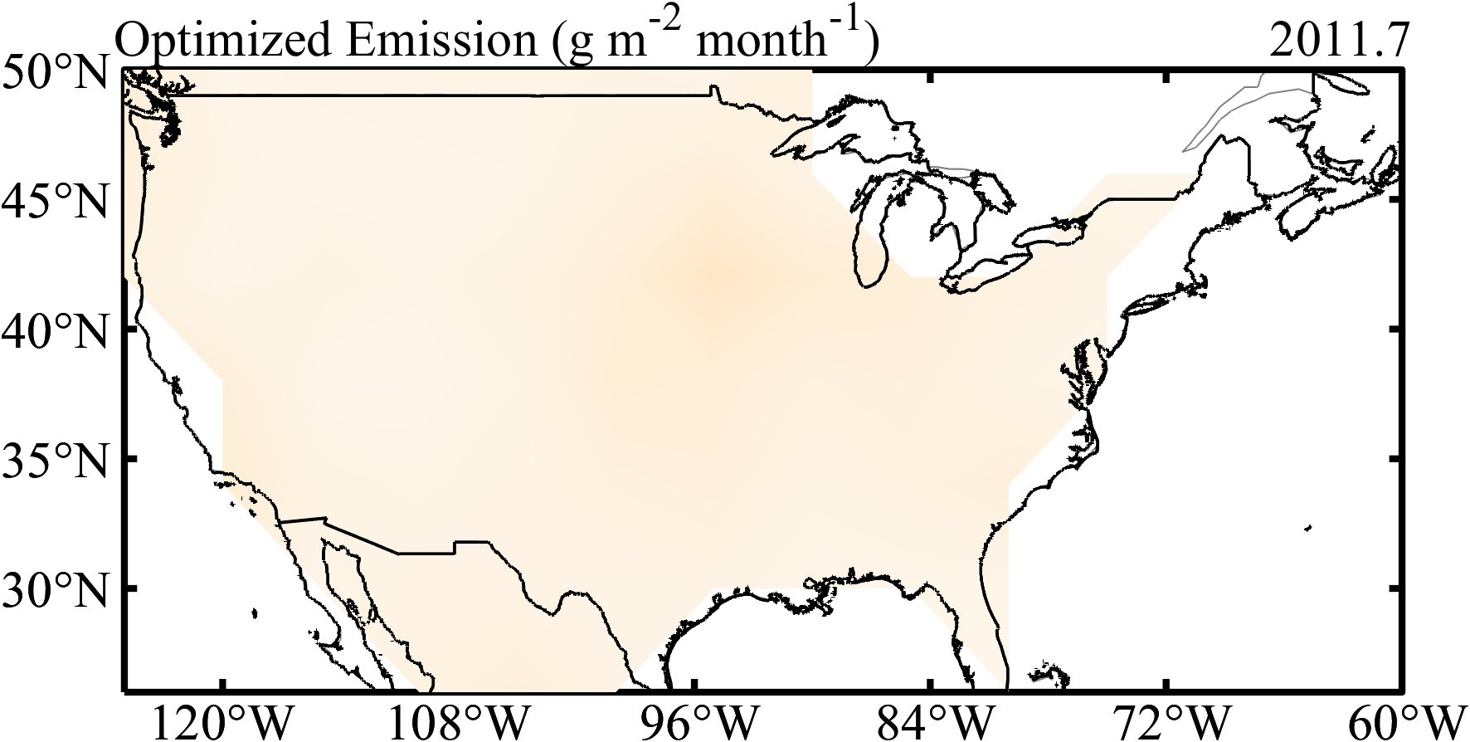
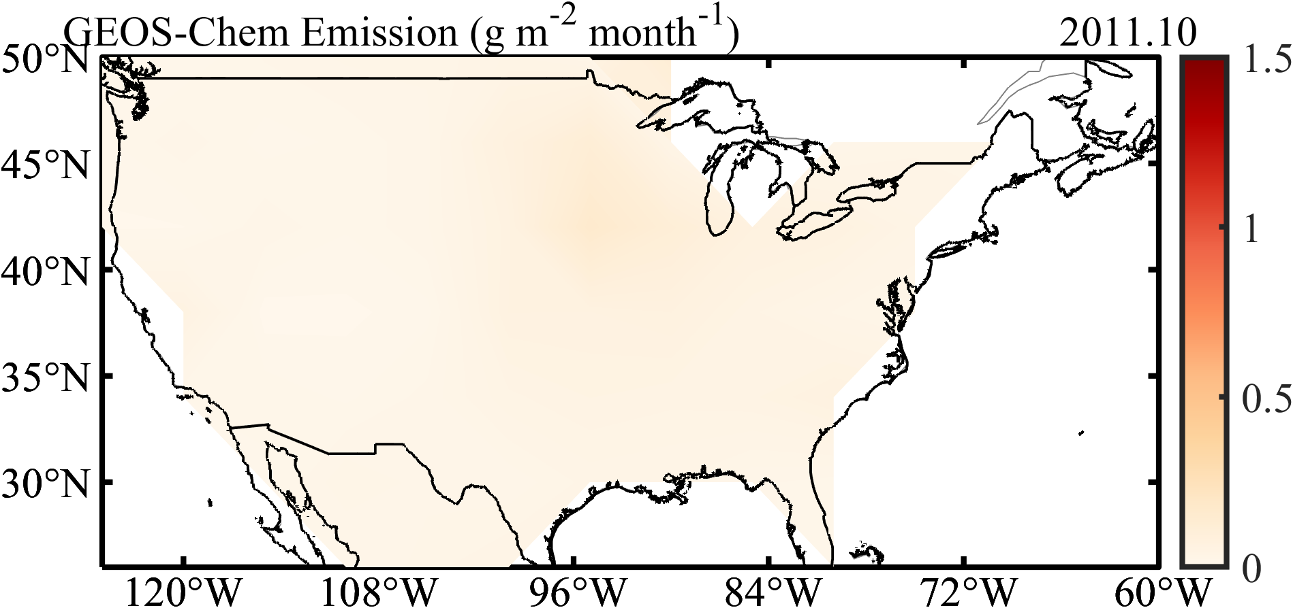
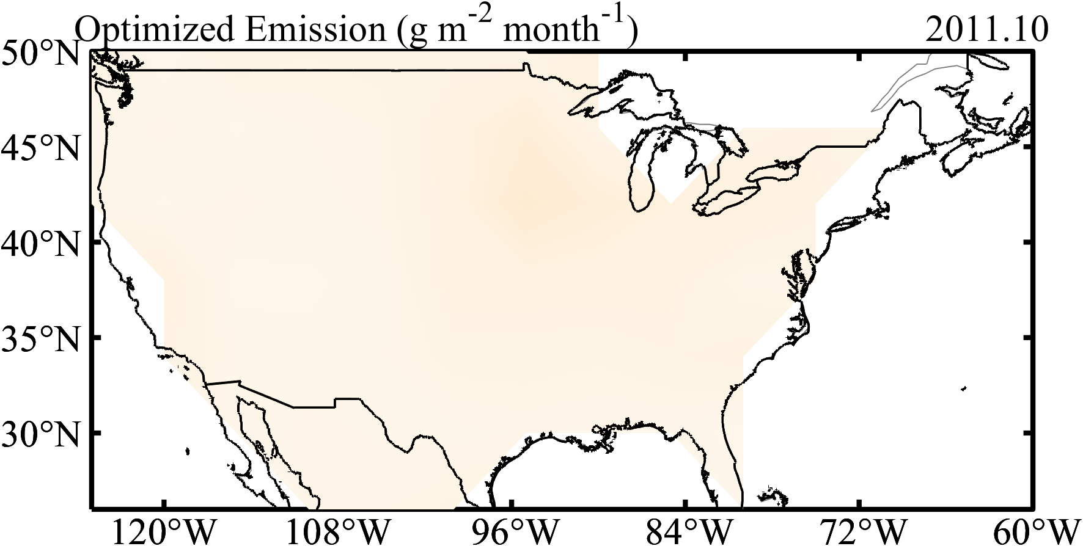
Analysis
(Chen et al., 2021)
(Gg) | 2011.4 | 2011.7 | 2011.10
2011 NEI | 462 | 475 | 304
Chen et al optimized | 623 | 564 | 335
increase | 35% | 19% | 10%
GEOS-Chem | 572 | 682 | 395
Our study | 684 | 707 | 395
increase | 20% | 4% | 0%

Slide 4
litreature

Slide 5
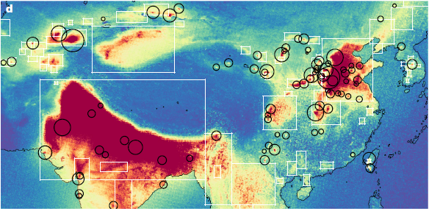
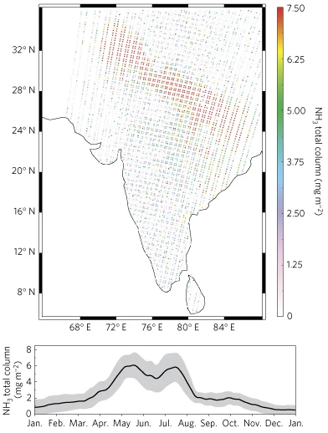
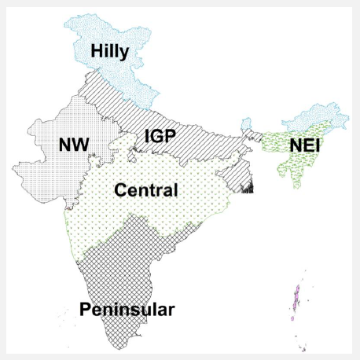
Atmospheric NH3 over India, 2008-2016
IASI average NH3 distribution over Asia
(Van Damme et al., 2018) Nature
source
agricultural activities——major source (80% in Asia)
animal husbandry
nitrogenous fertilizers
manure management
soil and water management practices
biomass burning——the second-largest contributor (13-16%)
space instruments
AIRS——2002~
IASI——2006~
ANNI-NH3-v2.2R-I
9.30 AM
CriS——2011~
TANSO–FTS——2018~
TES——2004~
Indo-Gangetic Plains (IGP)——NH3 emission hotspot
Zaid (March-May, MAM)——pre-monsoon
Kharif (June–September, JJAS)——monsoon
Rabi (October–February, ONDJF)——post-monsoon
Other data
PM——NAMP/CPCB
Rainfall——IMD
Total fertilizer consumption——the fertilizer association of India
fire count——MODIS
meteorology——ERAI
Population——Indian Population Census 2011
IASI 2008.5.13 distribution over India and Pakistan
(Clarisse et al., 2009) Nature Geoscience
(Kuttippurath et al., 2020)
Notes:
https://doi.org/10.1016/j.scitotenv.2020.139986

Slide 6
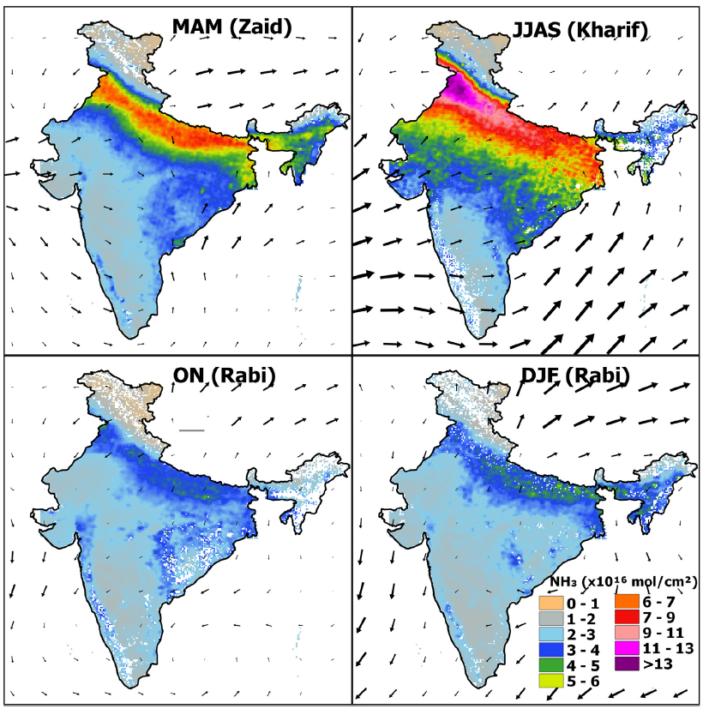
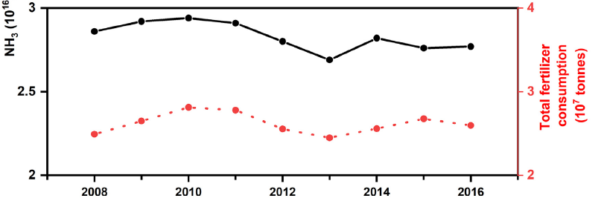
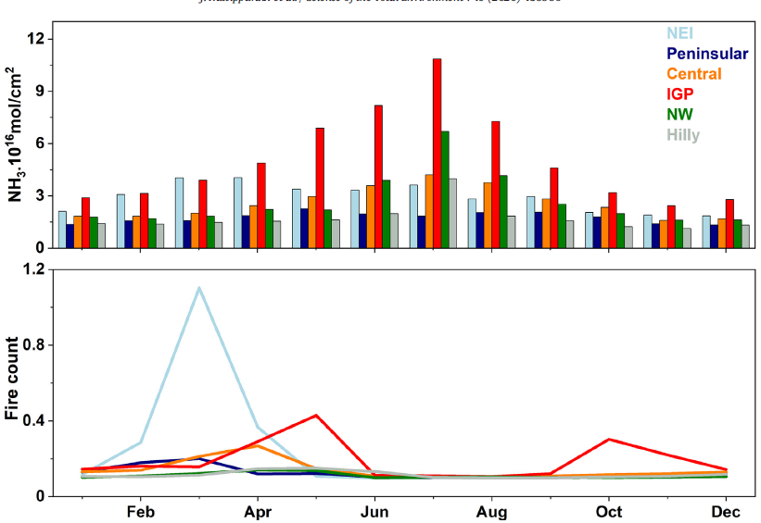
Atmospheric NH3 over India, 2008-2016
Seasonal changes
IGP: the largest NH3 concentrations
large seasonal variability
different agriculture intensive regions
fire counts
the northeast regions: in spring
IGP: double peak
Inter-annual variability
2010: the highest
(Kuttippurath et al., 2020)
Notes:
https://doi.org/10.1016/j.scitotenv.2020.139986

Slide 7
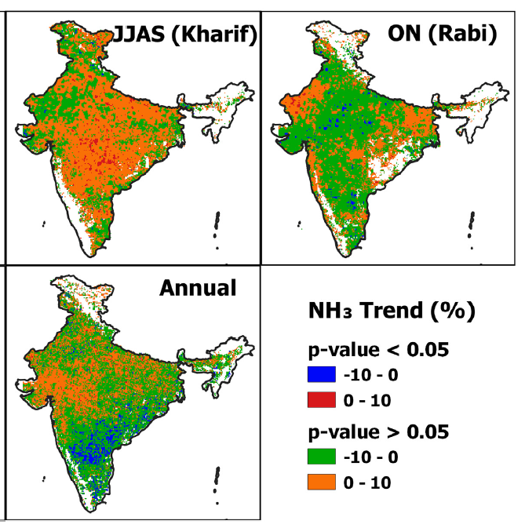
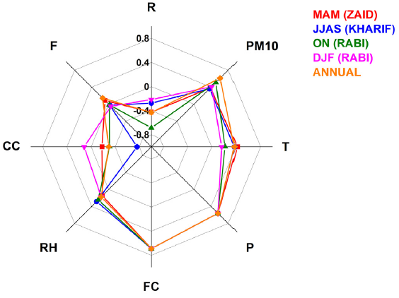
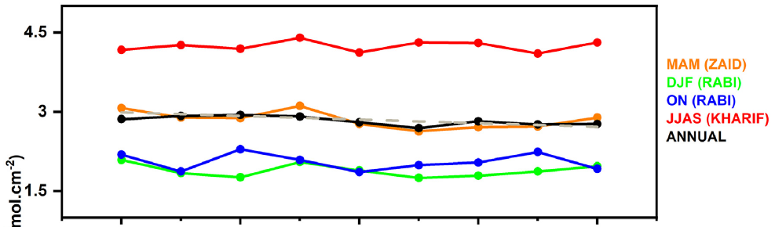
Atmospheric NH3 over India, 2008-2016
Impact——JJAS
meteorological factors
Precipitation
Temperature
socio-economic factors
Fertilizer consumption
Trends
JJAS: insignificant positive
ONDJF: insignificant negative
MAM: significant negative
(Kuttippurath et al., 2020)
Notes:
https://doi.org/10.1016/j.scitotenv.2020.139986

Slide 8
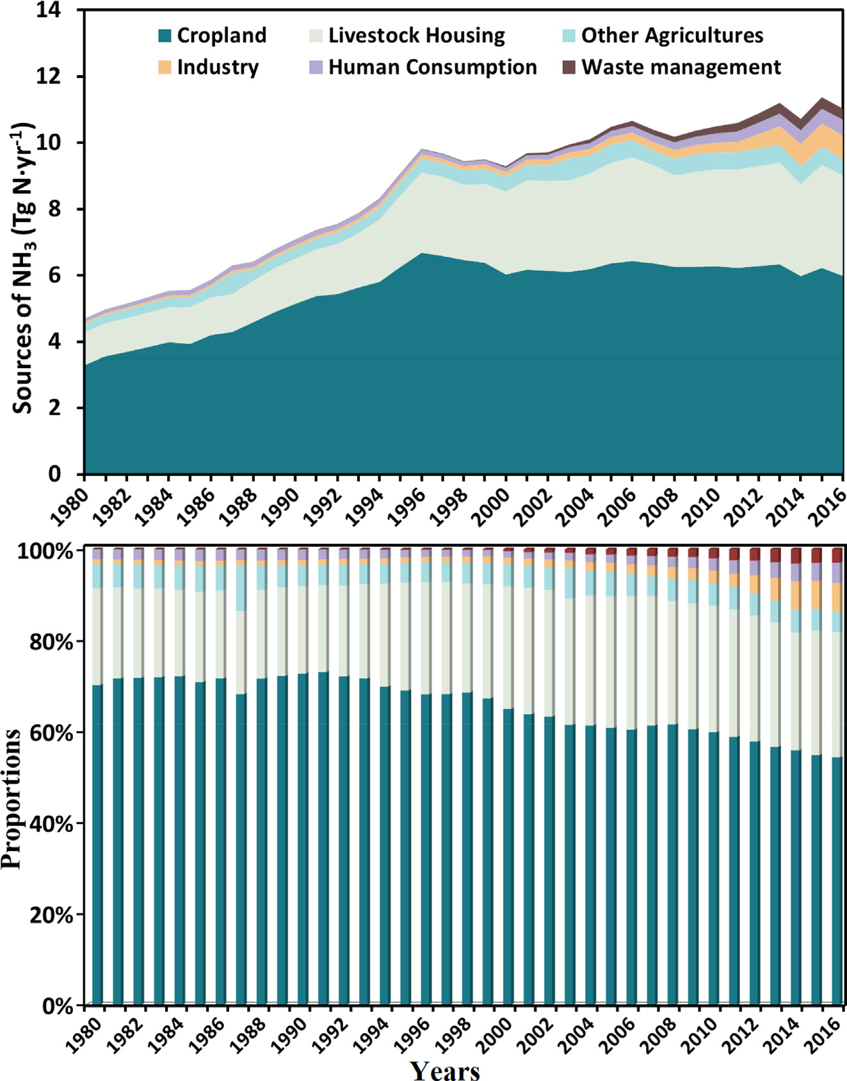
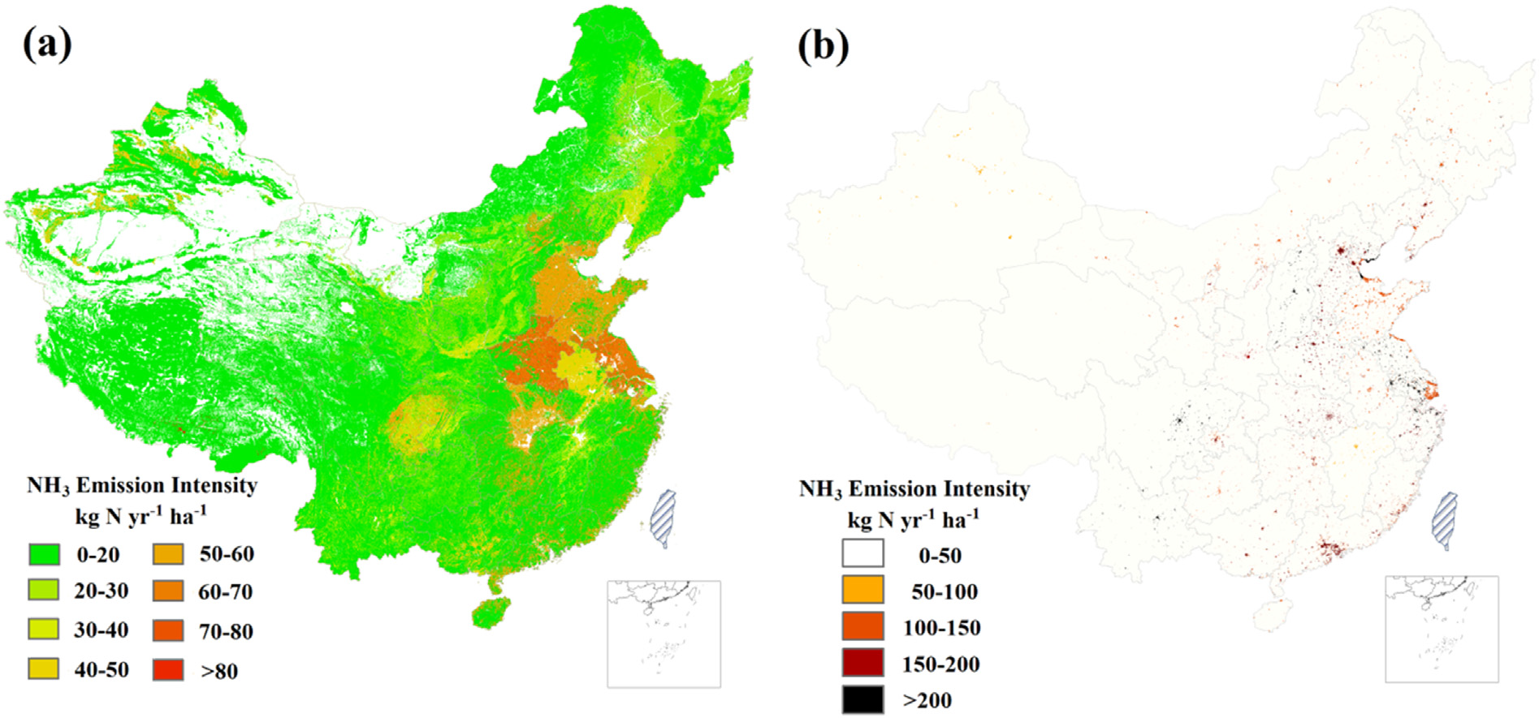
NH3 emission in China
policies and strategies——eliminate haze and ameliorate air quality
the Blue Sky Protection Campaign
the Air Pollution Prevention and Control Action Plan
Model——coupled human-environment N cycle (CHEN)
E = EF × A
E: total NH3 emissions
EF: emission factor
A: activity data
Data:
statistical yearbooks and databases
national resource survey statistics
literature
spatial information models
Temporal evolution
Major are high: > 80%
Minor proportion are increasing: 9% -> 19%
Spatial variations
agriculture
nonagriculture
(Fu et al., 2020)
Notes:
https://doi.org/10.1016/j.scitotenv.2020.138897

Slide 9
Questions?

